Slide 1
1. jQuery Effects and Events

Slide 2
What is jQuery?
jQuery is a lightweight, "write less, do more", JavaScript library.
The purpose of jQuery is to make it much easier to use JavaScript on your website.
jQuery takes a lot of common tasks that require many lines of JavaScript code to accomplish, and wraps them into methods that you can call with a single line of code.
jQuery also simplifies a lot of the complicated things from JavaScript, like AJAX calls and DOM manipulation.
The jQuery library contains the following features:
HTML/DOM manipulation
CSS manipulation
HTML event methods
Effects and animations
AJAX
Utilities

Slide 3
Advantages of jQuery
Allows to add animated effects to HTML elements.
Enables a web pages to make AJAX requests to a web server to add data without reloading the page.
Allow to manipulate DOM by adding, removing and reordering the content of a web page.
Allows you to create animated image slideshows, animated multi-level dropdown menus and drag and drop interface.

Slide 4
Loading jQuery
jQuery is available in the form of a single file that has the extension .js.
The jQuery library is a single JavaScript file, and reference it with the HTML <script> tag
Note: <script> tag should be inside the <head> section.
Example:
<head> <script src="jquery-3.5.1.min.js"></script> </head>

Slide 5
jQuery syntax
With jQuery you select (query) HTML elements and perform "actions" on them.
$(selector).action()
A $ sign to define/access jQuery
A (selector) to "query (or find)" HTML elements
A jQuery action() to be performed on the element(s)

Slide 6
Examples:
$(this).hide() - hides the current element.
$("p").hide() - hides all <p> elements.
$(".test").hide() - hides all elements with class="test".
$("#test").hide() - hides the element with id="test".

Slide 7
jQuery reads or manipulates a DOM document by using ready event of the document.
Syntax:
$(document). ready(function(){
//add your code here
});
ready event always includes an event handler.

Slide 8
For example, inside the ready event, you can add a click handler to the link:
$( document ).ready(function() {
$( "a" ).click(function( event ) {
alert( “Anchor link clicked!" );
});
});

Slide 9
this keyword
Refers to the current context of a function.
Default context of the this keyword is the window object.

Slide 10
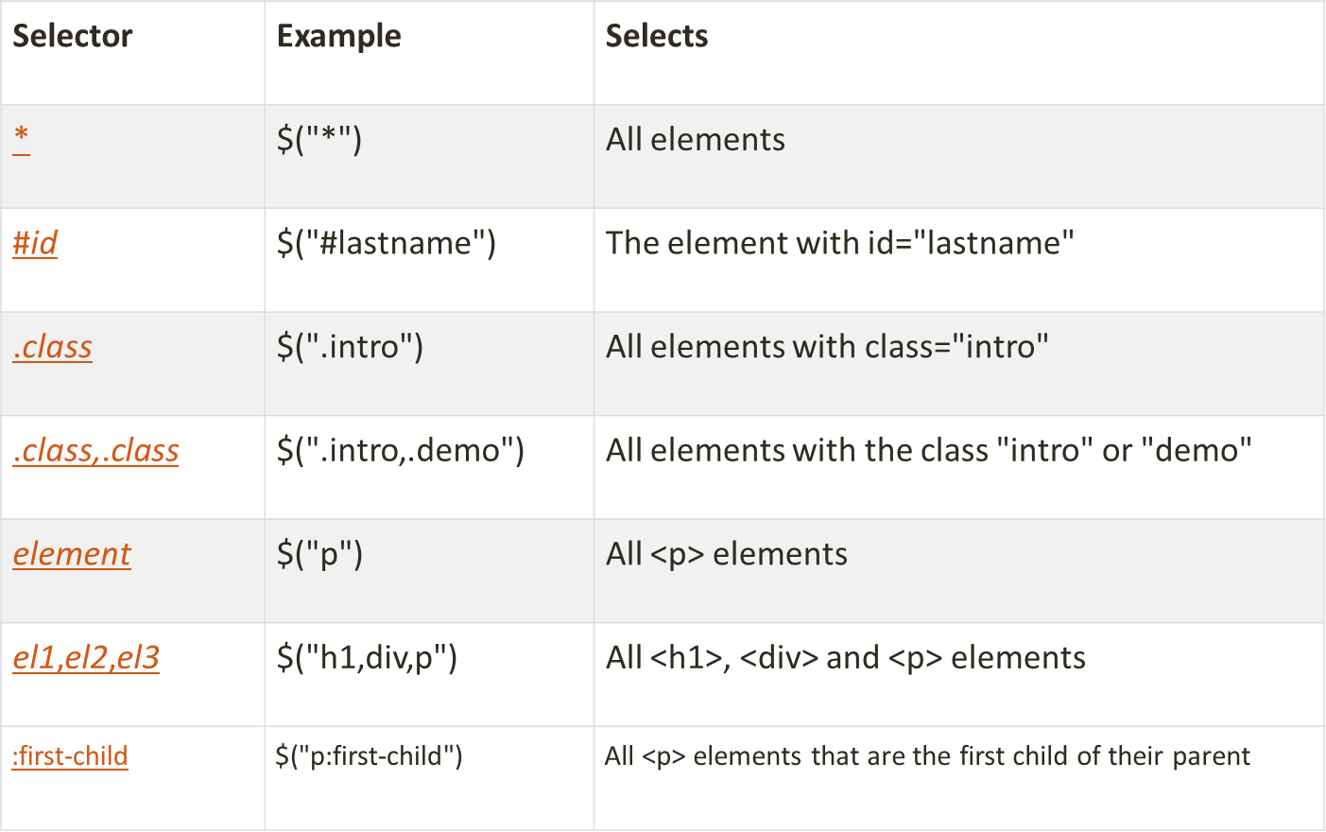
jQuery Selectors

Slide 11
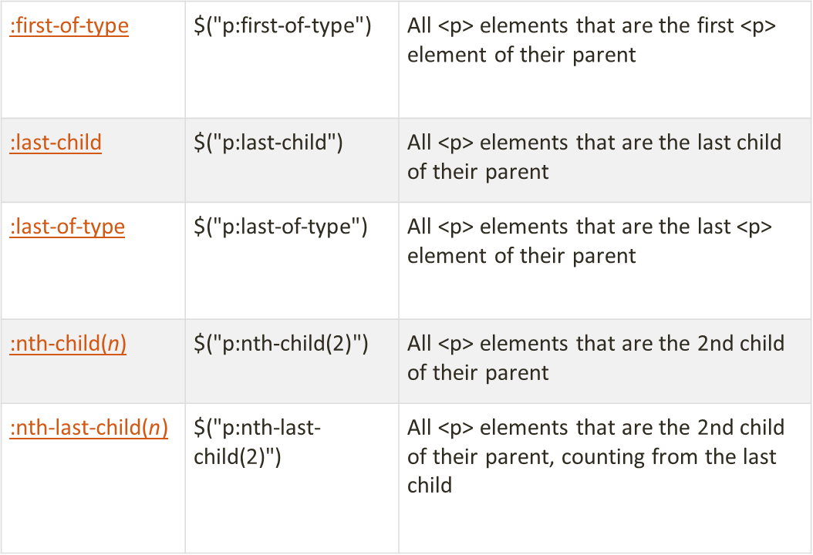

Slide 12
Examples:
$(“p#para”)
$(“p.para”)
$(“[href]”)
$(“[href=‘#’]”)
$(“[href!=‘#’]”)
$(“[href=‘.jpg’]”)
Selects all <p> element with id=“para”
Selects all <p> element with class =“para”
Select all elements with an href attribute
Selects all elements with an href value equal to #
Selects all elements with an href value is not equal to #.
Selects all elements with an href attribute that ends with .jpg

Slide 13
find() method
The find() method returns descendant elements of the selected element.
A descendant is a child, grandchild, great-grandchild, and so on.
Syntax:
$(selector).find(filter)

Slide 14
Methods to access HTML Attributes
attr( )
removeAttr( )
html( )
text( )
addClass( )
removeClass( )

Slide 15
Form elements and web page events
blur
change
focus
load
resize
scroll
select
submit
Unload(removed in version 3)

Slide 16
blur event
The blur event occurs when an element loses focus.
Syntax:
$(selector).blur(function()
{
});

Slide 17
change event
The change event occurs when the value of an element is changed (only works on form fields).
Note: For select menus, the change event occurs when an option is selected. For text fields or text areas, the change event occurs when the field loses focus.
Syntax:
$(selector).change(function()
{
});

Slide 18
focus event
The focus event occurs when an element gets focus (when selected by a mouse click or by "tab-navigating" to it).
Syntax:
$(selector).focus(function()
{
});

Slide 19
load event
The load() method loads data from a server and puts the returned data into the selected element.
Sysntax:
$(selector).load(url,data)

Slide 20
resize() event
The resize event occurs when the browser window changes size.
Syntax:
$(selector).resize()

Slide 21
scroll event
The scroll event occurs when the user scrolls in the specified element.
The scroll event works for all scrollable elements and the window object (browser window).
Syntax:
$(selector).scroll(function()
{
});

Slide 22
select event
The select event occurs when a text is selected (marked) in a text area or a text field.
The select() method triggers the select event, or attaches a function to run when a select event occurs.
Syntax:
$(selector).select(function()
{
});

Slide 23
submit event
The submit event occurs when a form is submitted.
This event can only be used on <form> elements.
Syntax:
$(selector).submit(function()
{
});

Slide 24
unload event
The unload event occurs when the user navigates away from the page.
Syntax:
$(window).unload(function)

Slide 25
Mouse operation and Keyboard events
Mouse Events:
mousedown
mousemove
mouseout
mouseover
mouseup
click
dblclick
Keyboard Events:
keydown
keypress
keyup

Slide 26
click event
The click event occurs when an element is clicked.
Syntax:
$(selector).click()
$(selector).click(function()
{
});

Slide 27
dblclick event
The dblclick event occurs when an element is double-clicked.
Syntax:
$(selector).dblclick()
$(selector).dblclick(function()
{
});

Slide 28
mouseover event
The mouseover event occurs when the mouse pointer is over the selected element.
The mouseover event triggers if a mouse pointer enters any child elements as well as the selected element.
Syntax:
$(selector).mouseover(function()
{
});

Slide 29
mouseout event
The mouseout event occurs when the mouse pointer leaves the selected element.
The mouseout event is triggered if a mouse pointer leaves any child elements as well as the selected element.
Syntax:
$(selector).mouseout(function()
{
});

Slide 30
mousedown event
The mousedown event occurs when the mouse button is pressed down over the selected element.
This method is often used together with the mouseup event.
Syntax:
$(selector).mousedown(function()
{
});

Slide 31
mouseup event
The mouseup event occurs when the mouse button is released over the selected element.
Syntax:
$(selector).mouseup(function()
{
});

Slide 32
mousemove event
The mousemove event occurs whenever the mouse pointer moves within the selected element.
Syntax:
$(selector).mousemove(function()
{
});

Slide 33
keypress event
Event fired when a key is pressed on the keyboard.
In case if you press any special key, browser will fire only keydown() event but not keypress() event.
Syntax:
$(selector).keypress(function()
{
});

Slide 34
keydown event
Event fired when a key is pressed on the keyboard.
Syntax:
$(selector).keydown(function()
{
});

Slide 35
keyup event
Event fired when a key is released on the keyboard.
Syntax:
$(selector).keyup(function()
{
});

